Slide 1
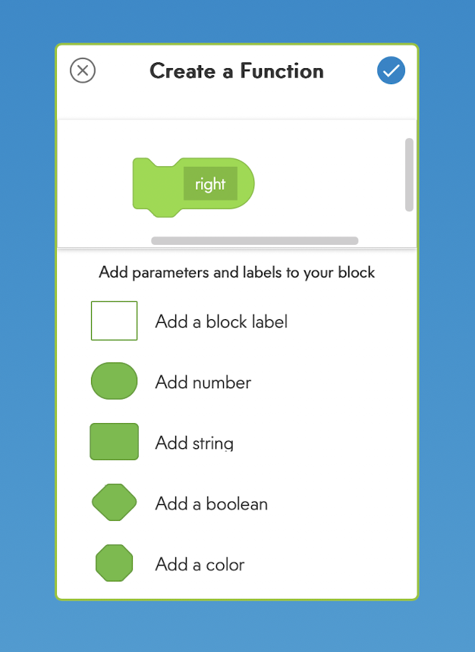

Slide 2
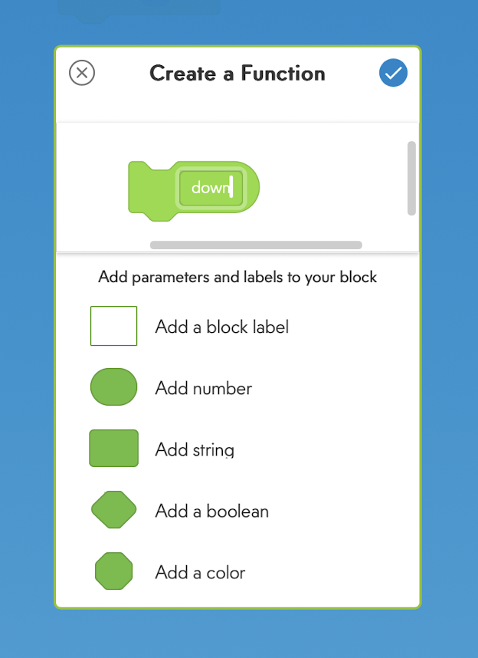

Slide 3
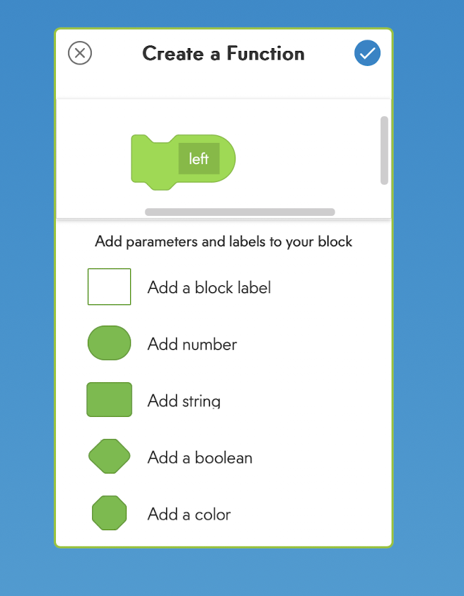

Slide 4
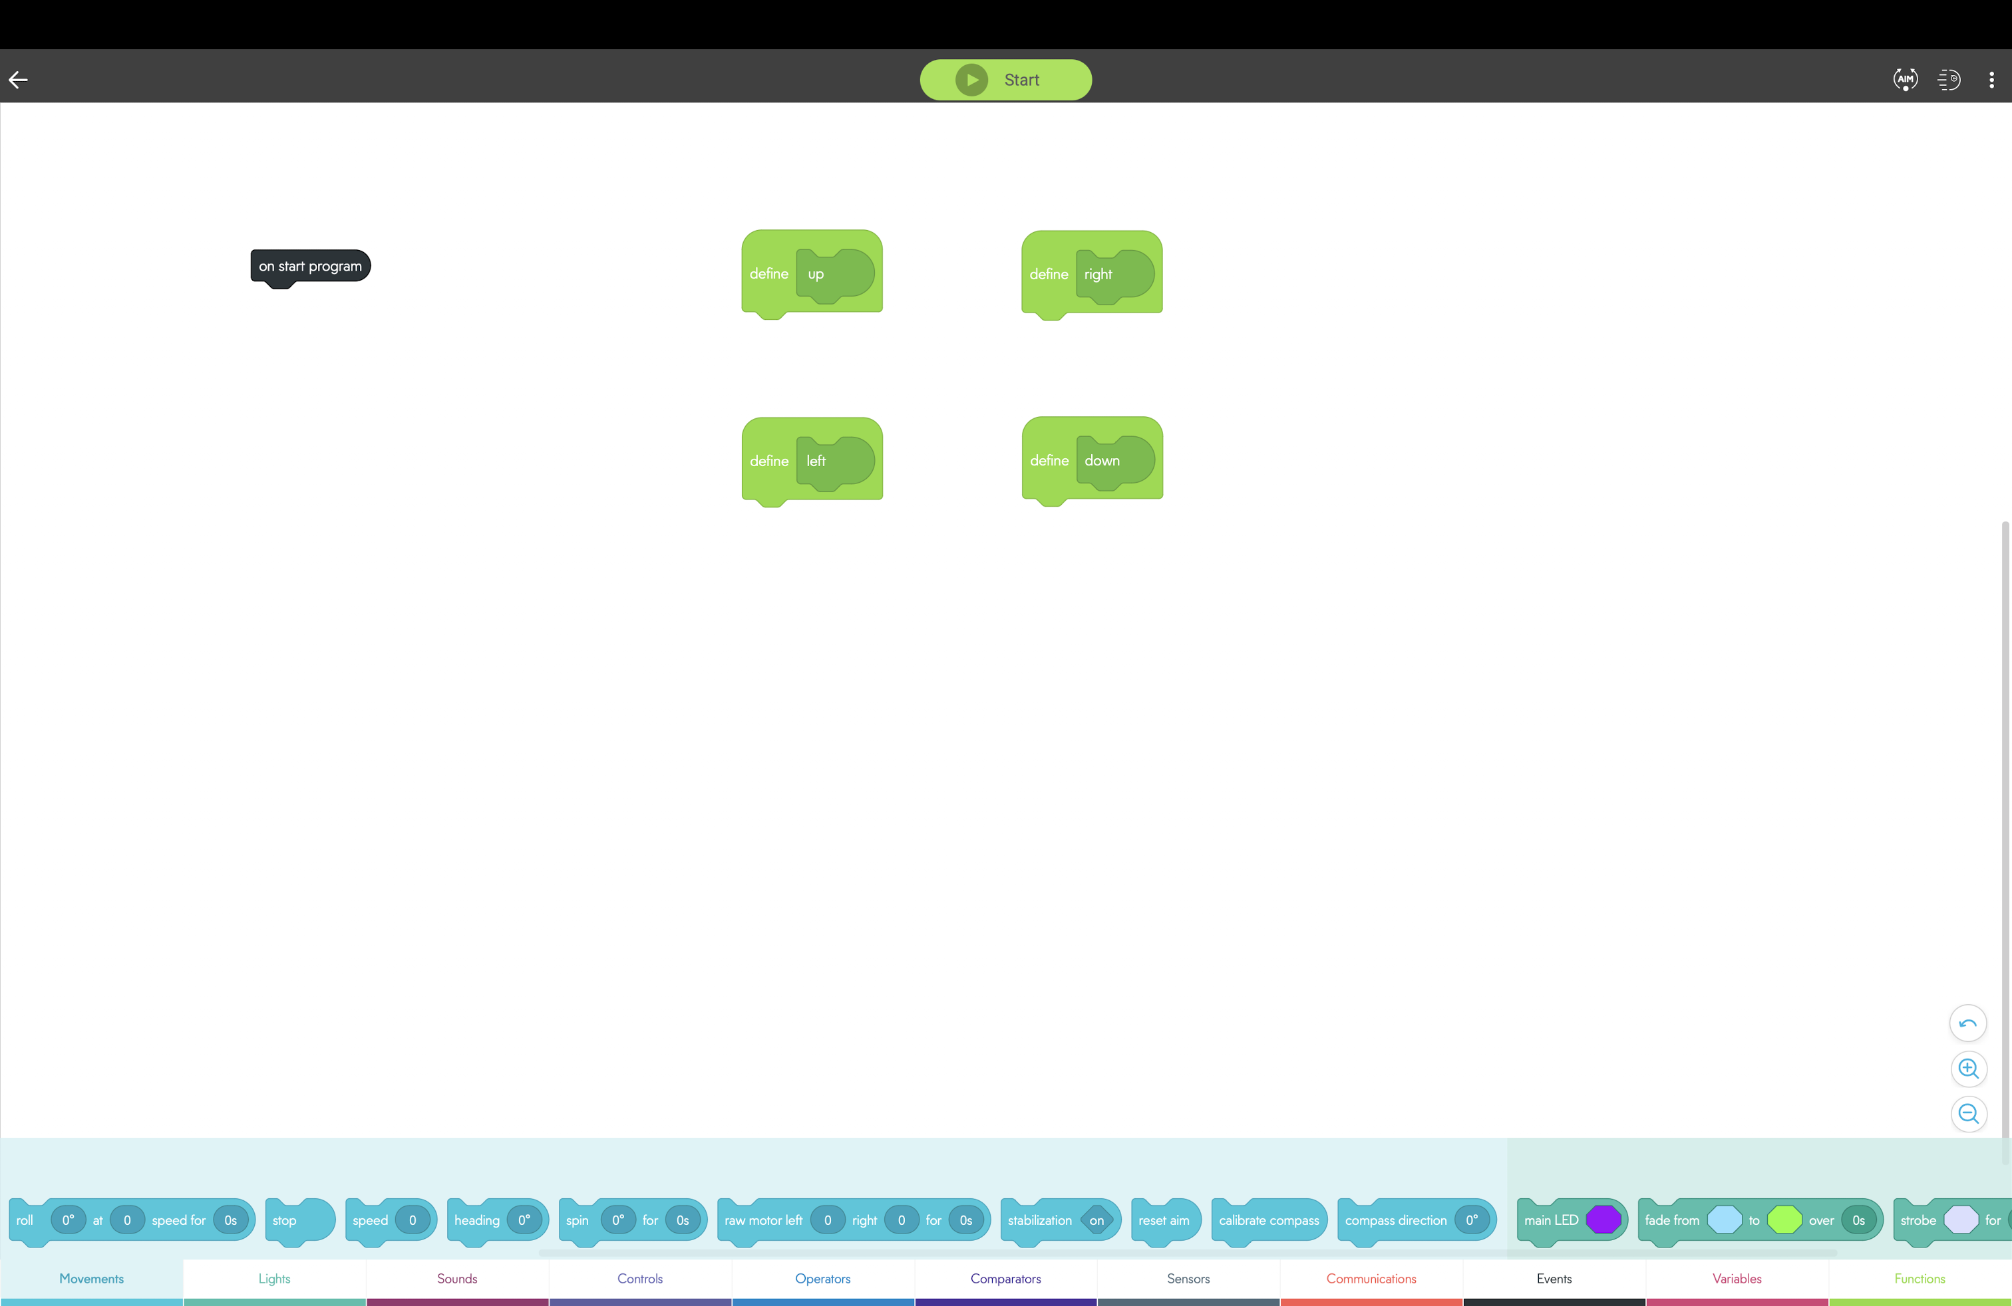
Drag this block to under “up” function

Slide 5
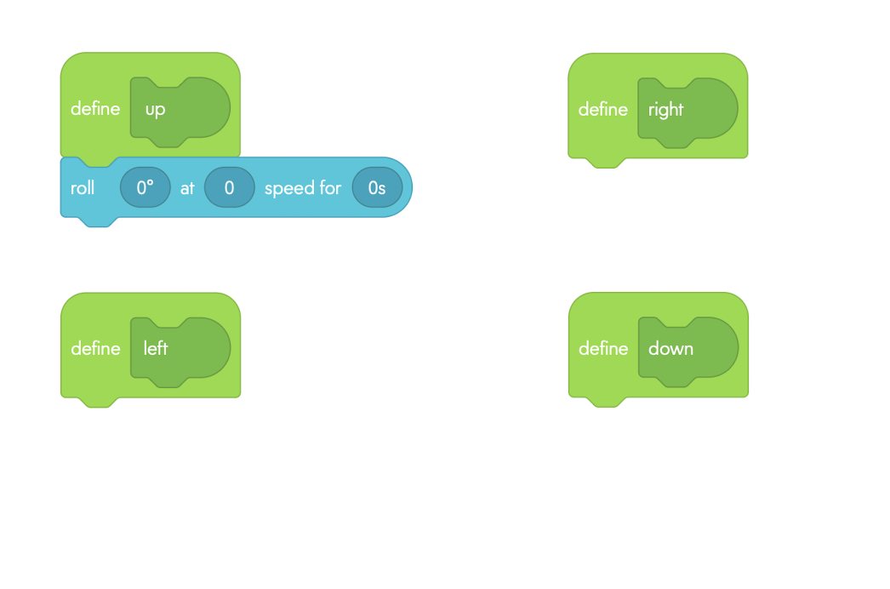

Slide 6
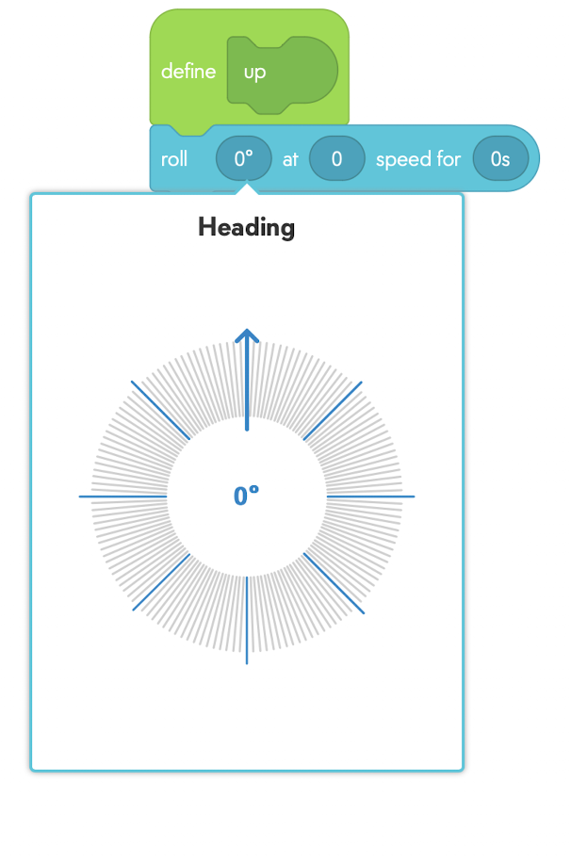
Tip: Click number to manually adjust value!

Slide 7
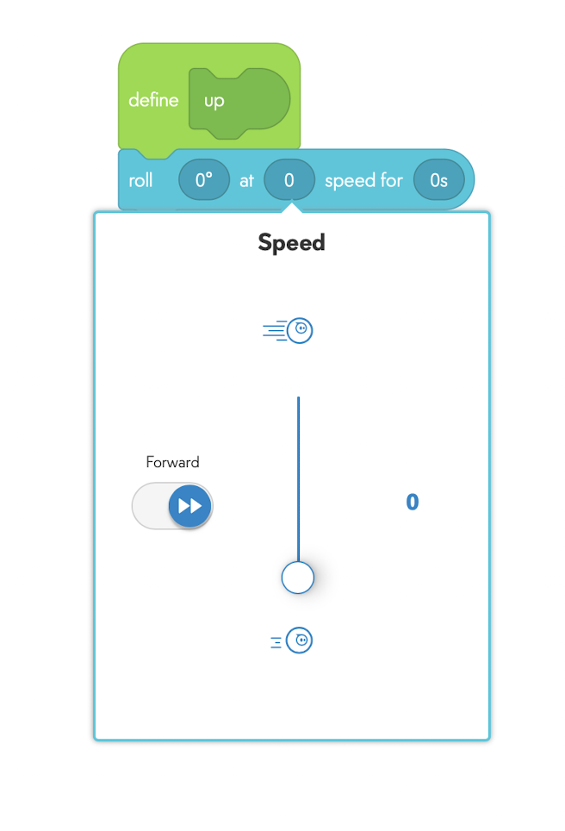
Click number to adjust value

Slide 8
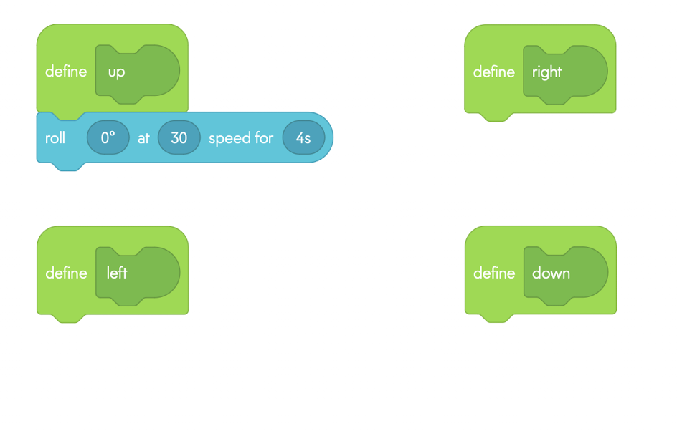

Slide 9
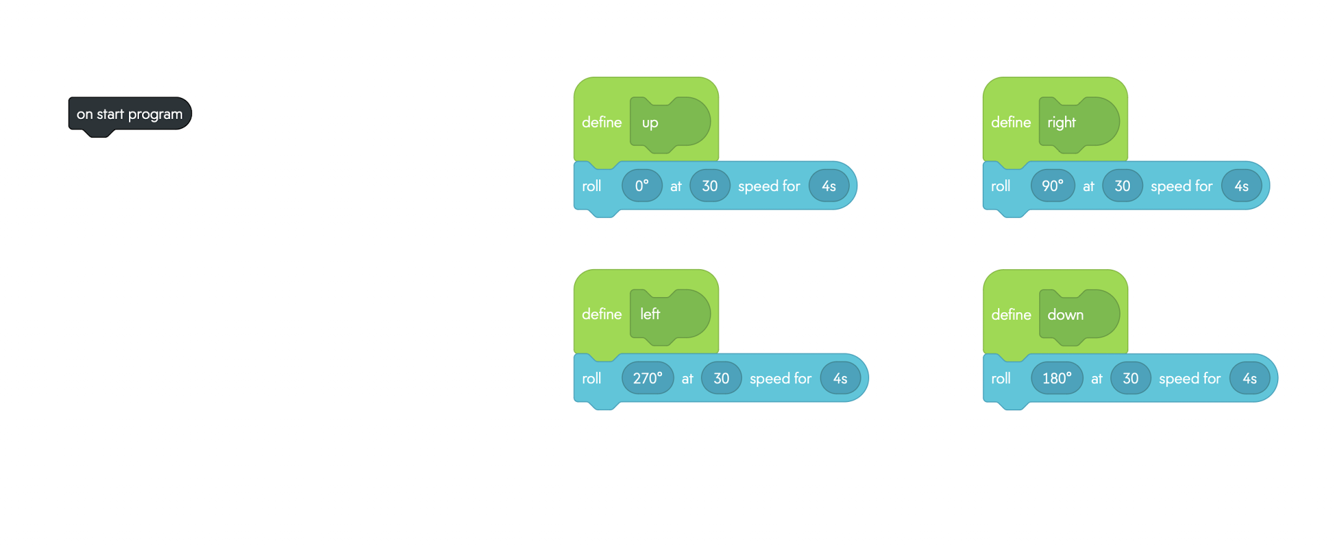
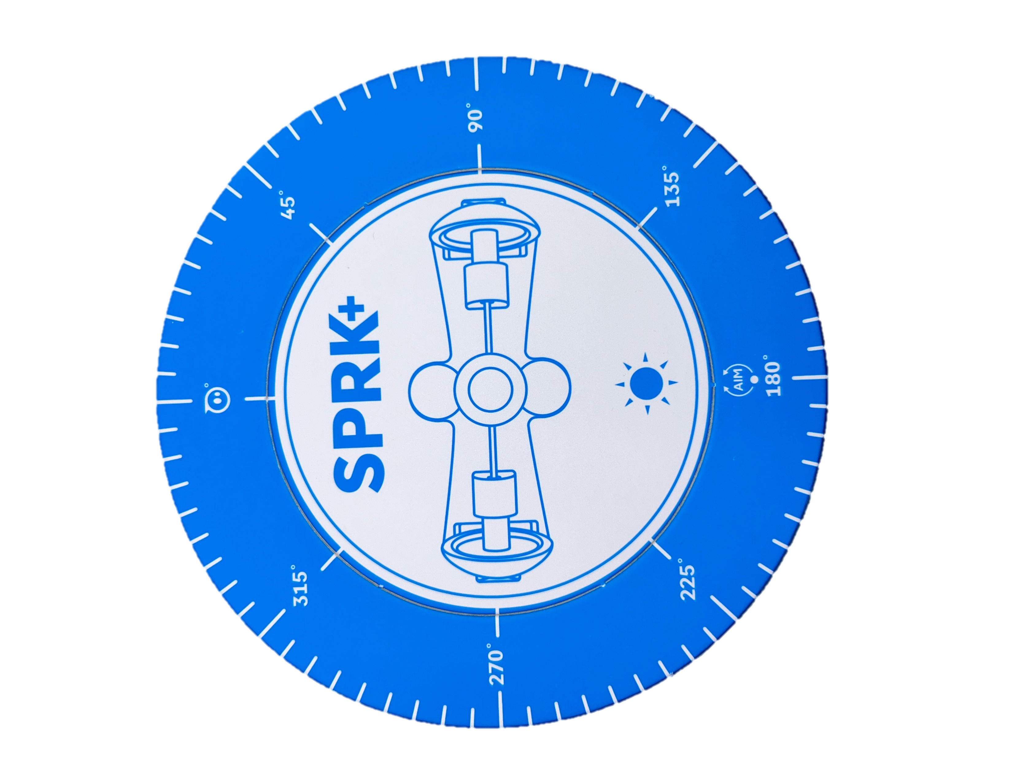

Slide 10
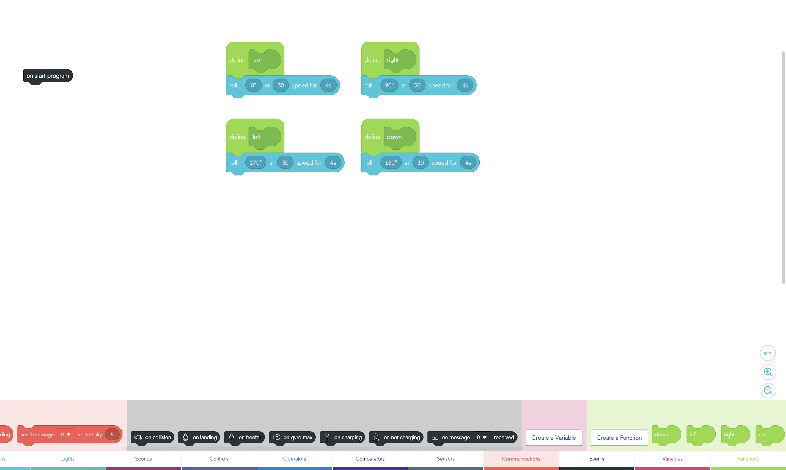

Drag the functions block here to under “on start program”
Experiment and see how they move

Slide 11
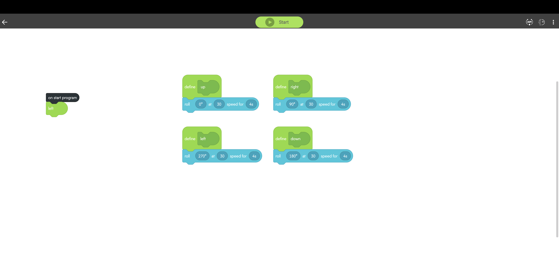
Aim the Sphero before running program​

Slide 12
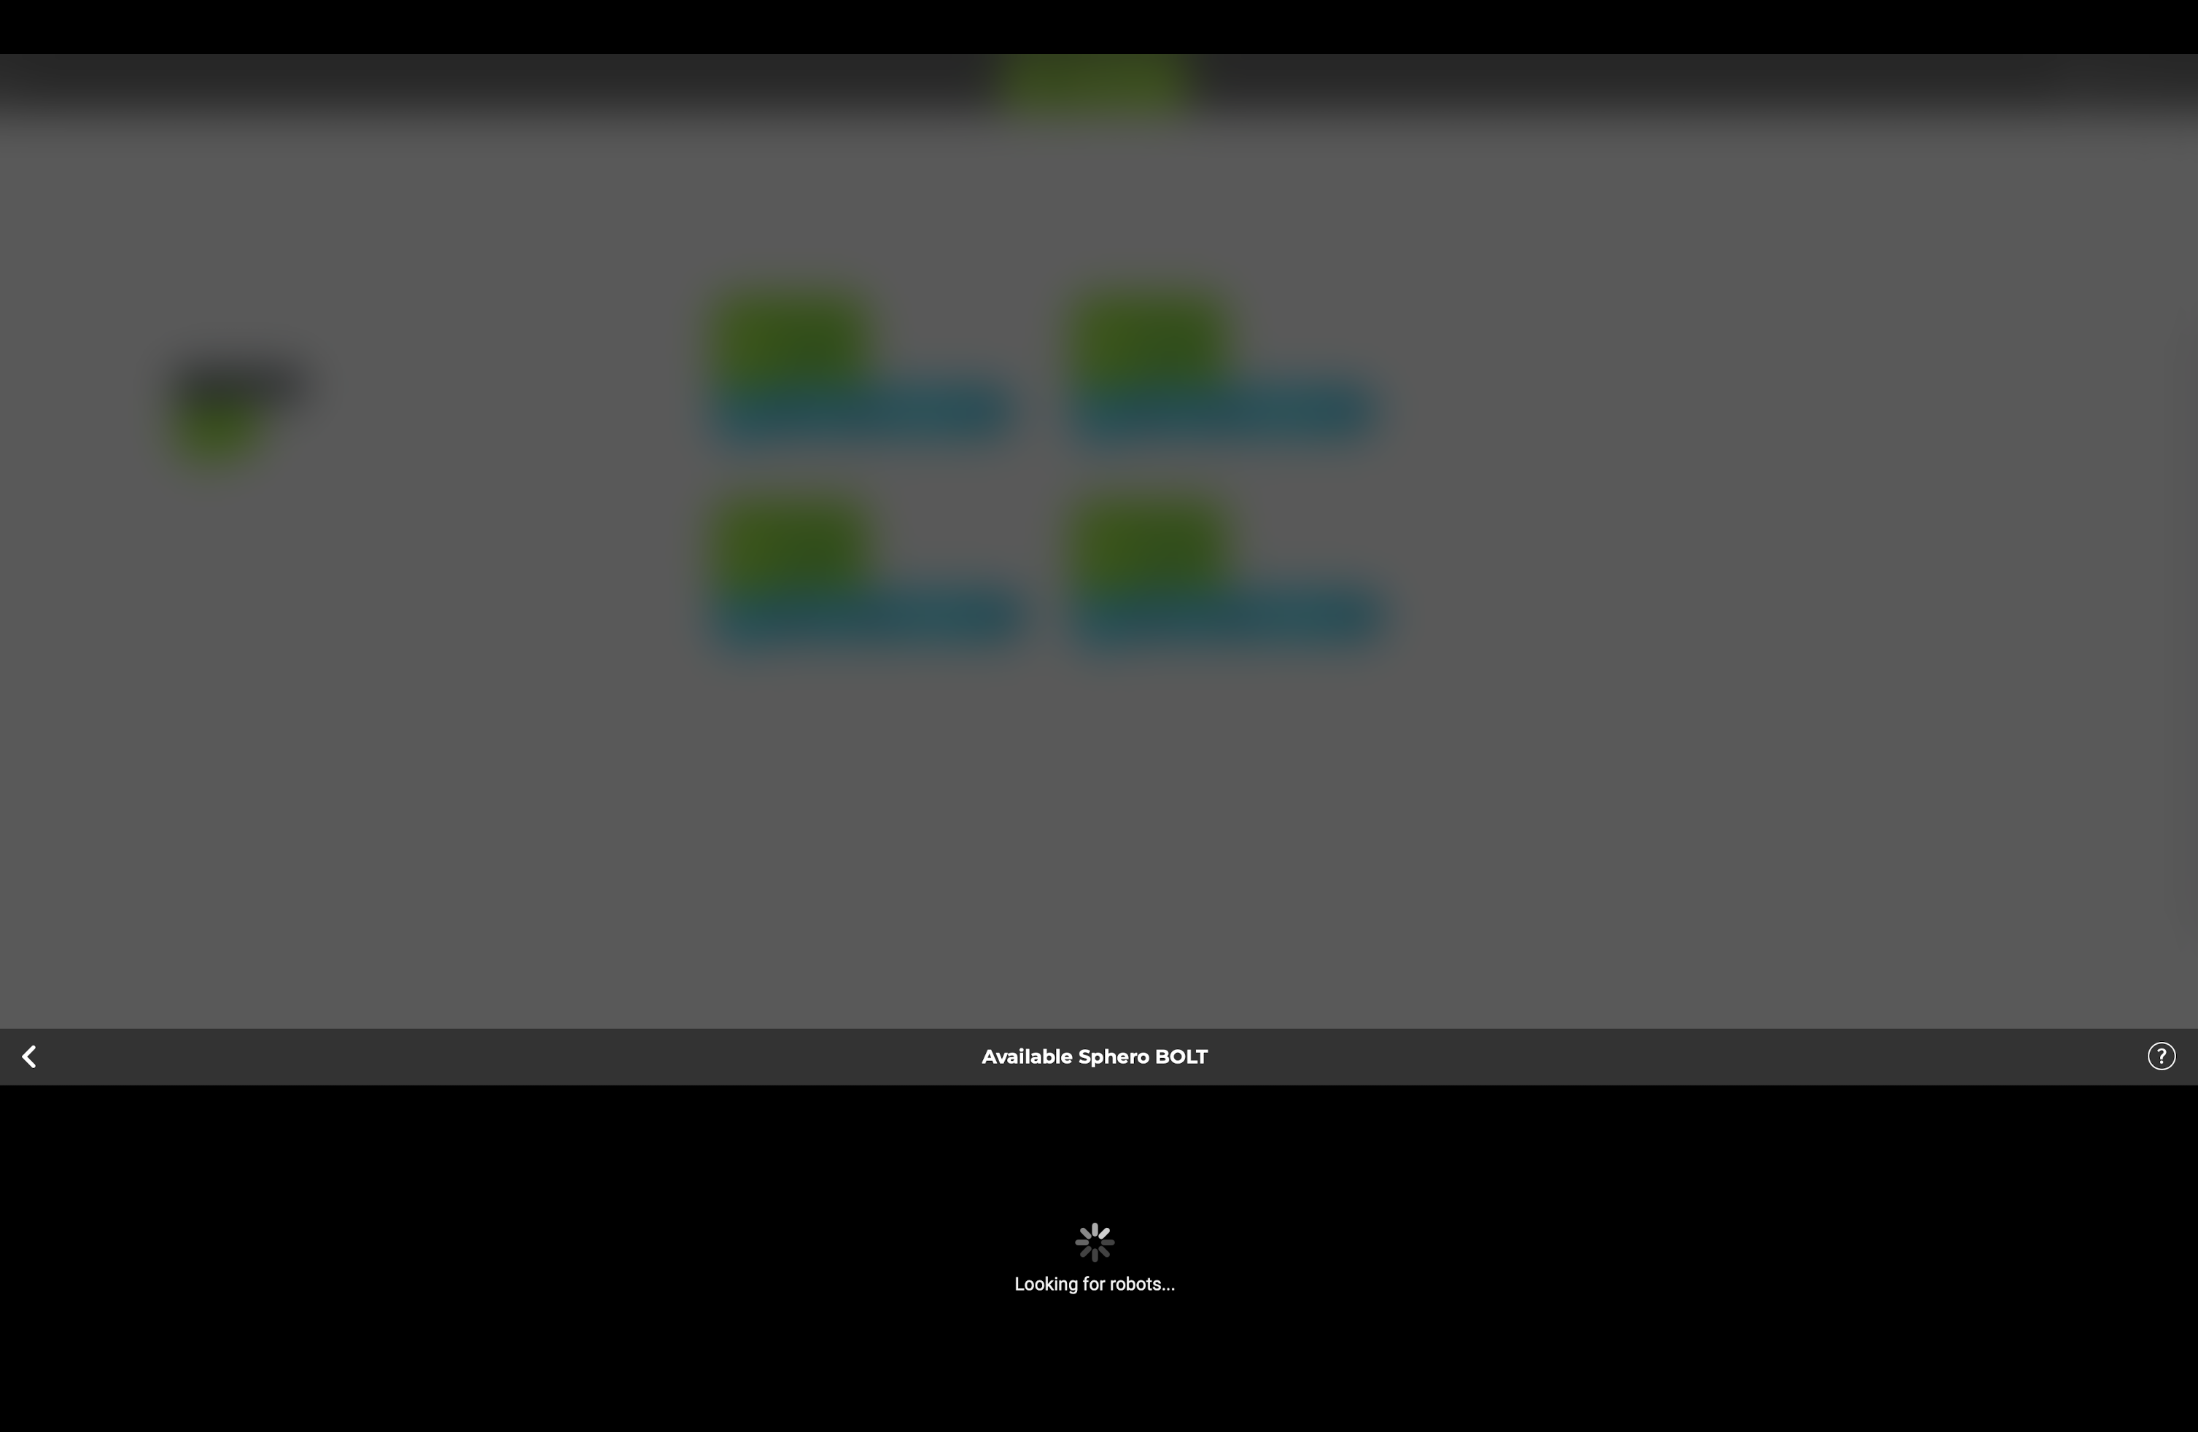

Slide 13
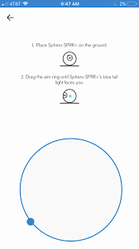
Make sure sphero’s blue dot ON THE HARDWARE is facing you.​

Slide 14
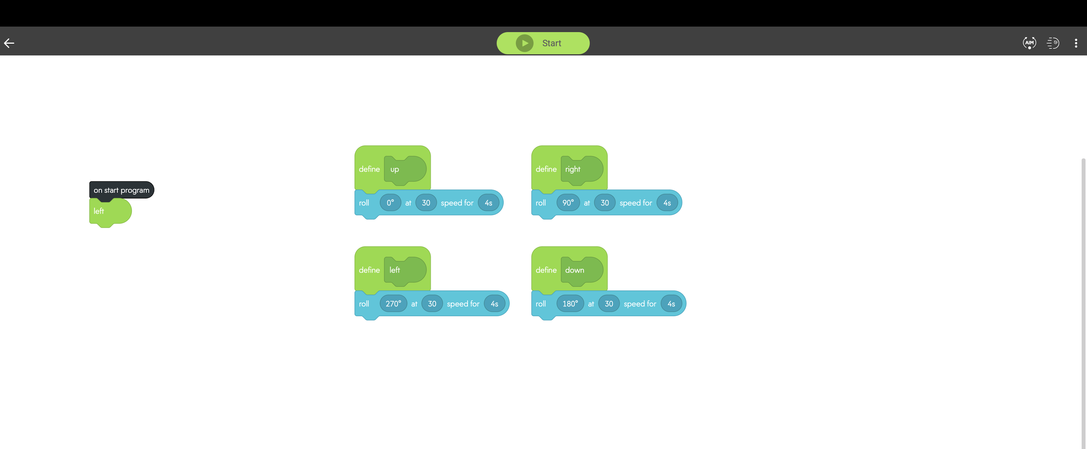

Slide 15
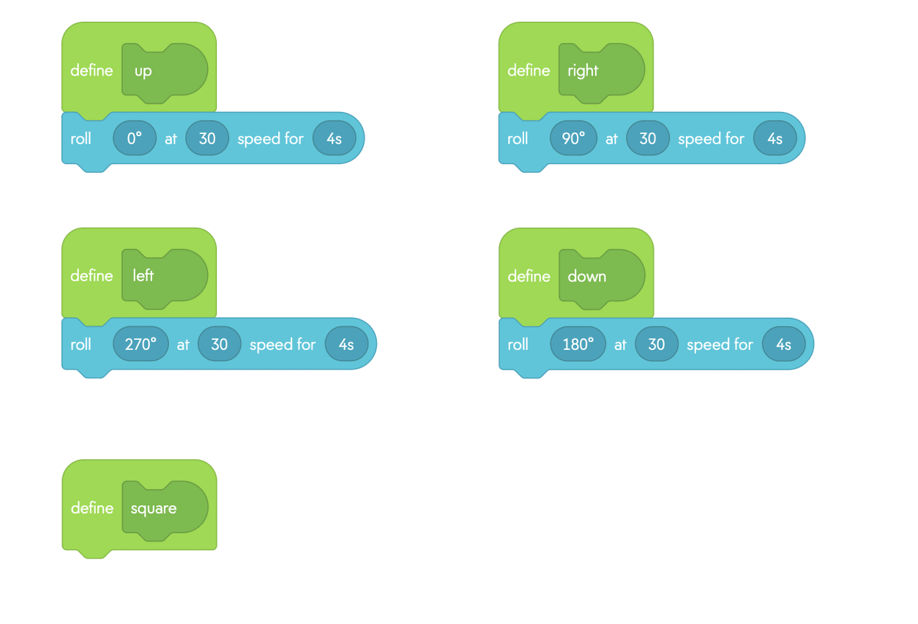
Create new function called “Square”

Slide 16
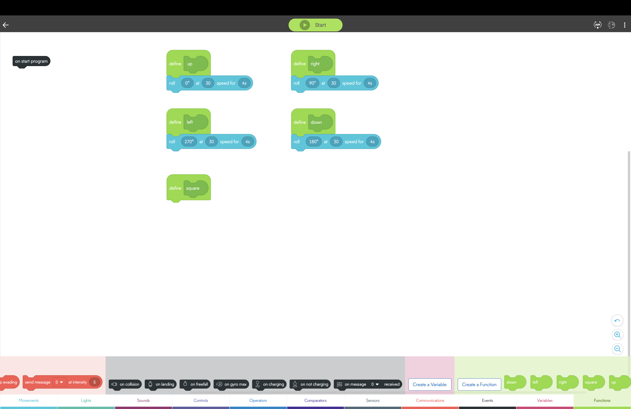
Drag the functions you just created to define a square

Slide 17
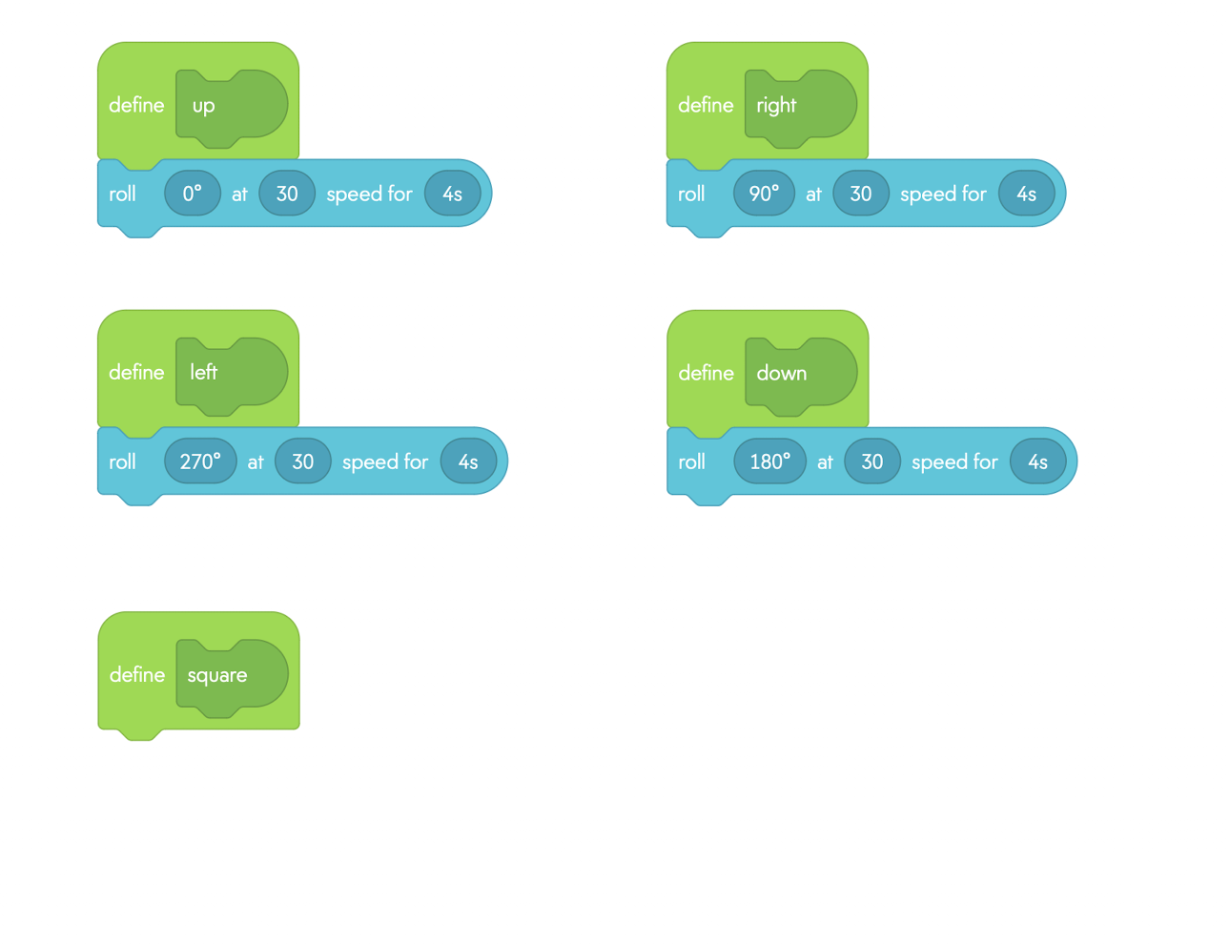
Now you try!
Finish the square

Slide 18
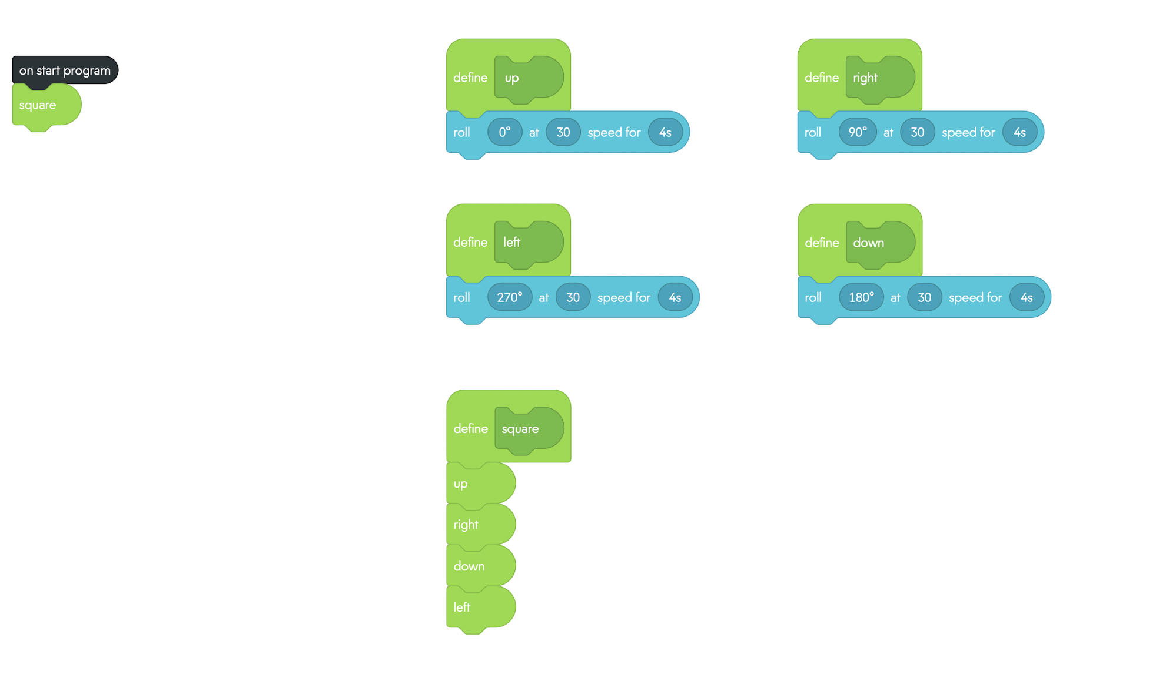
After you complete the square, drag the square function from the bottom bar to under “on start program”.
Now test your program

Slide 19
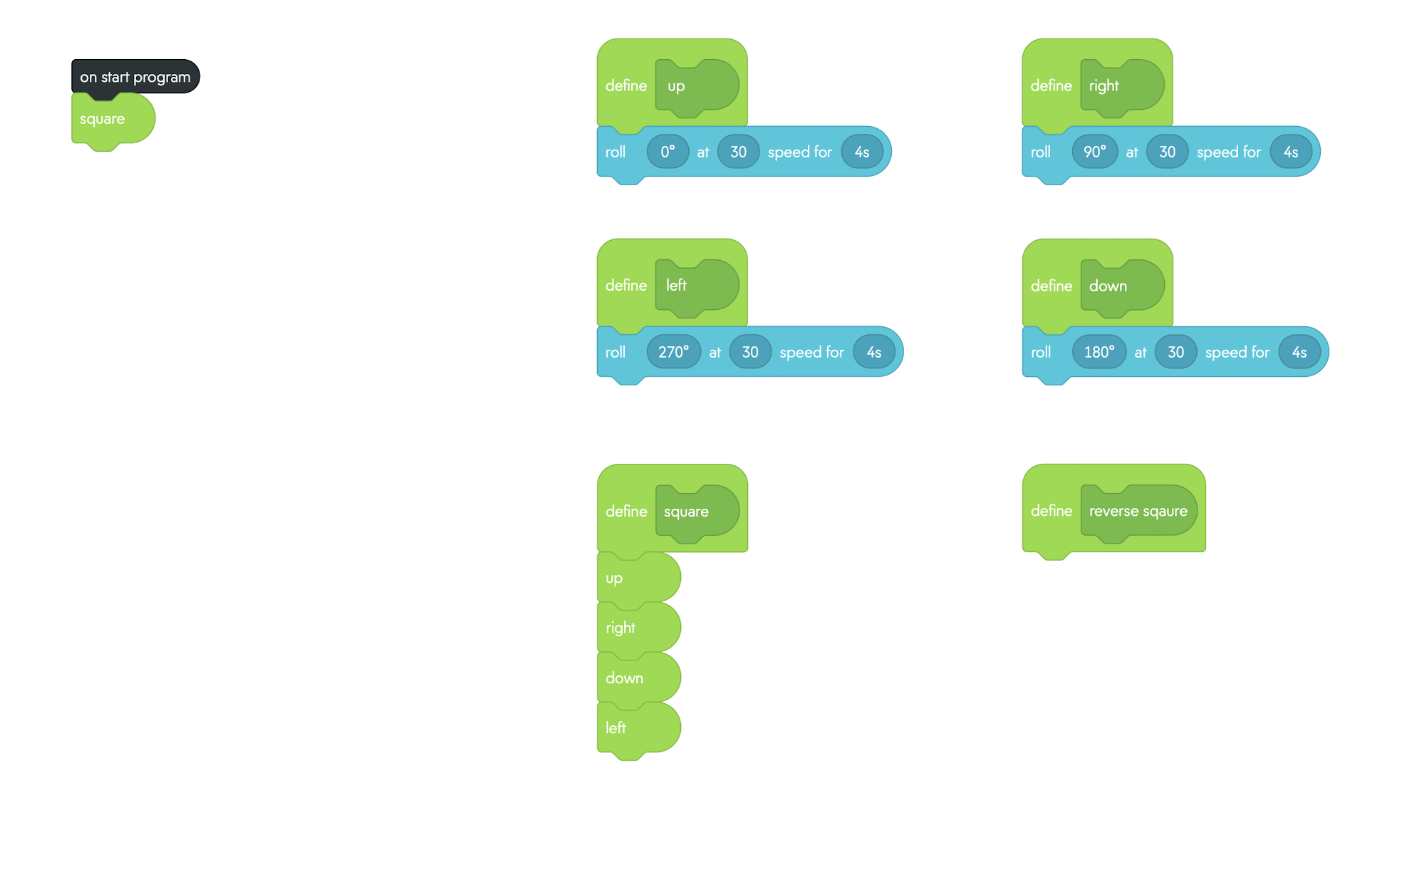
Try to create another function called “reverse square”
Now reverse the square!

Slide 20
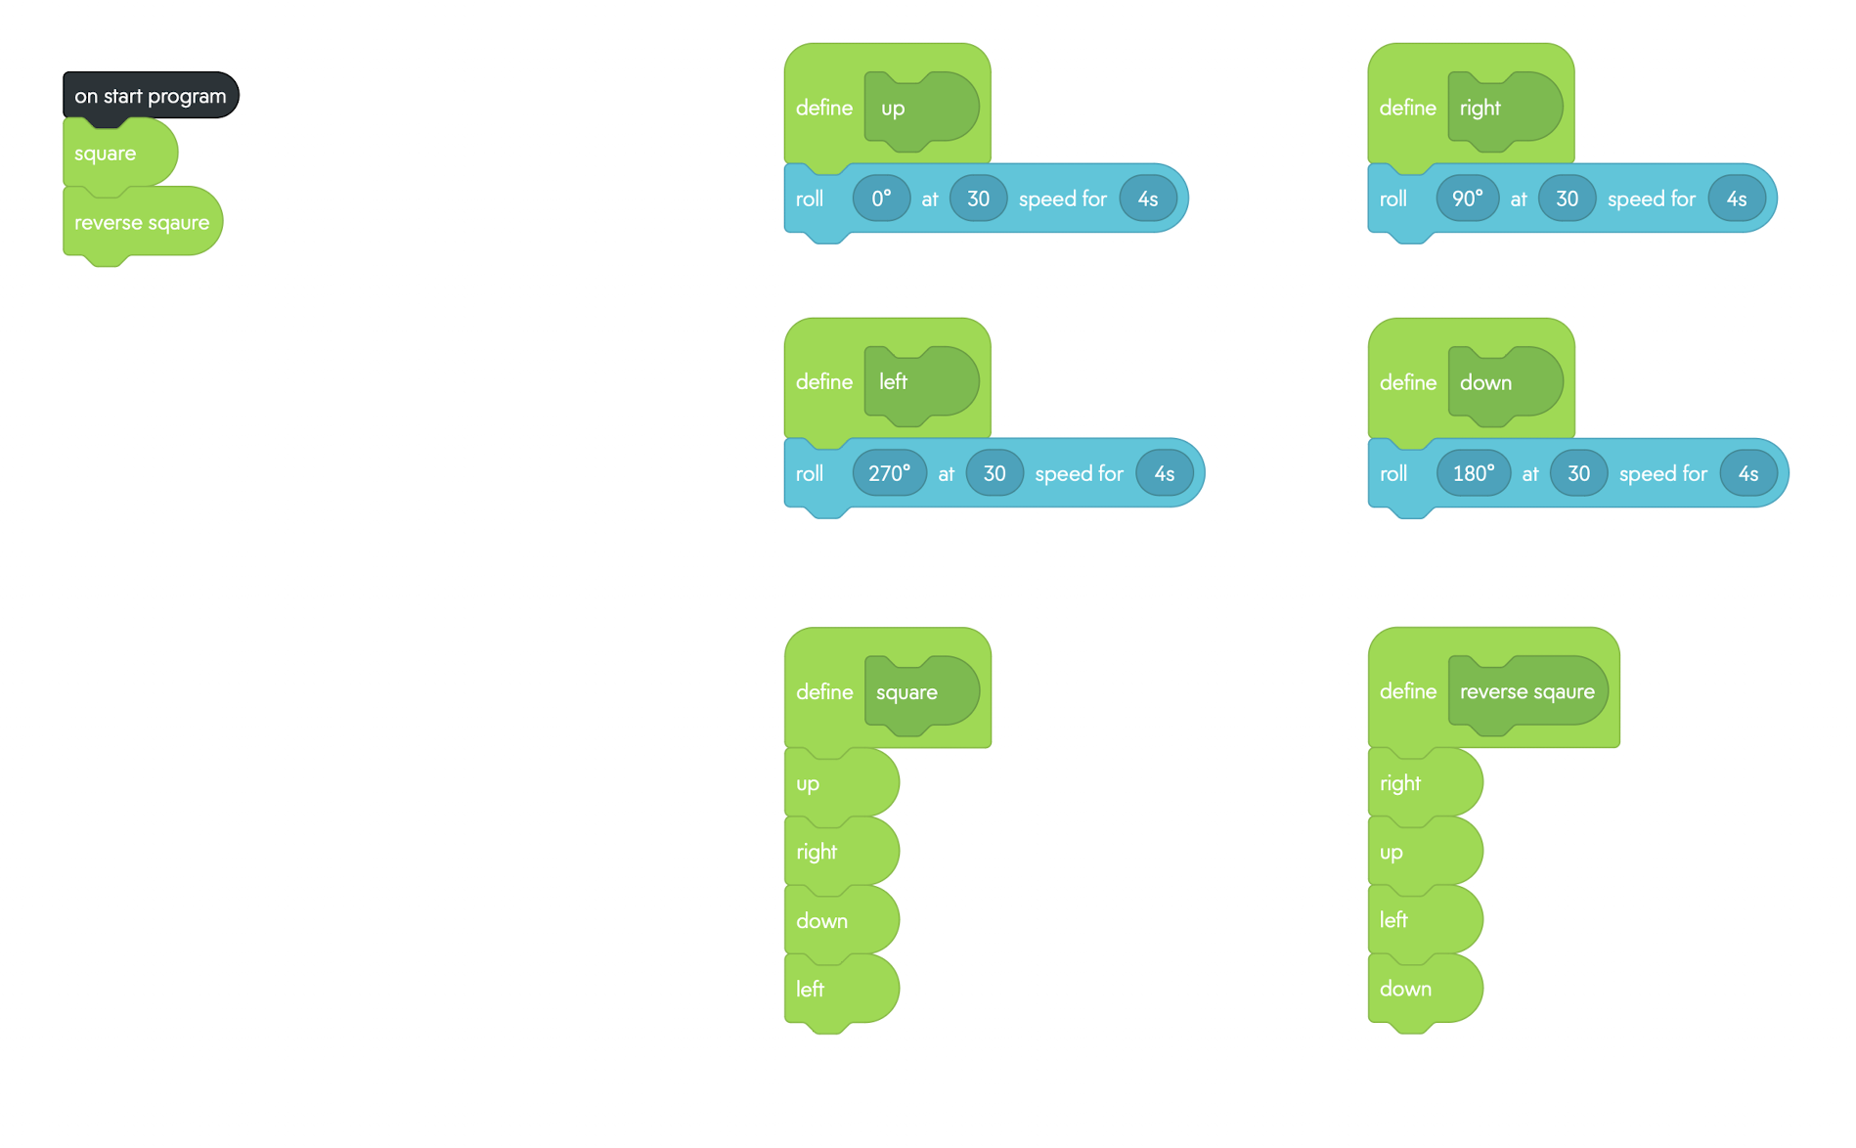
After defining “reverse square”, drag the function from the bottom to under the “on start program”

Slide 21
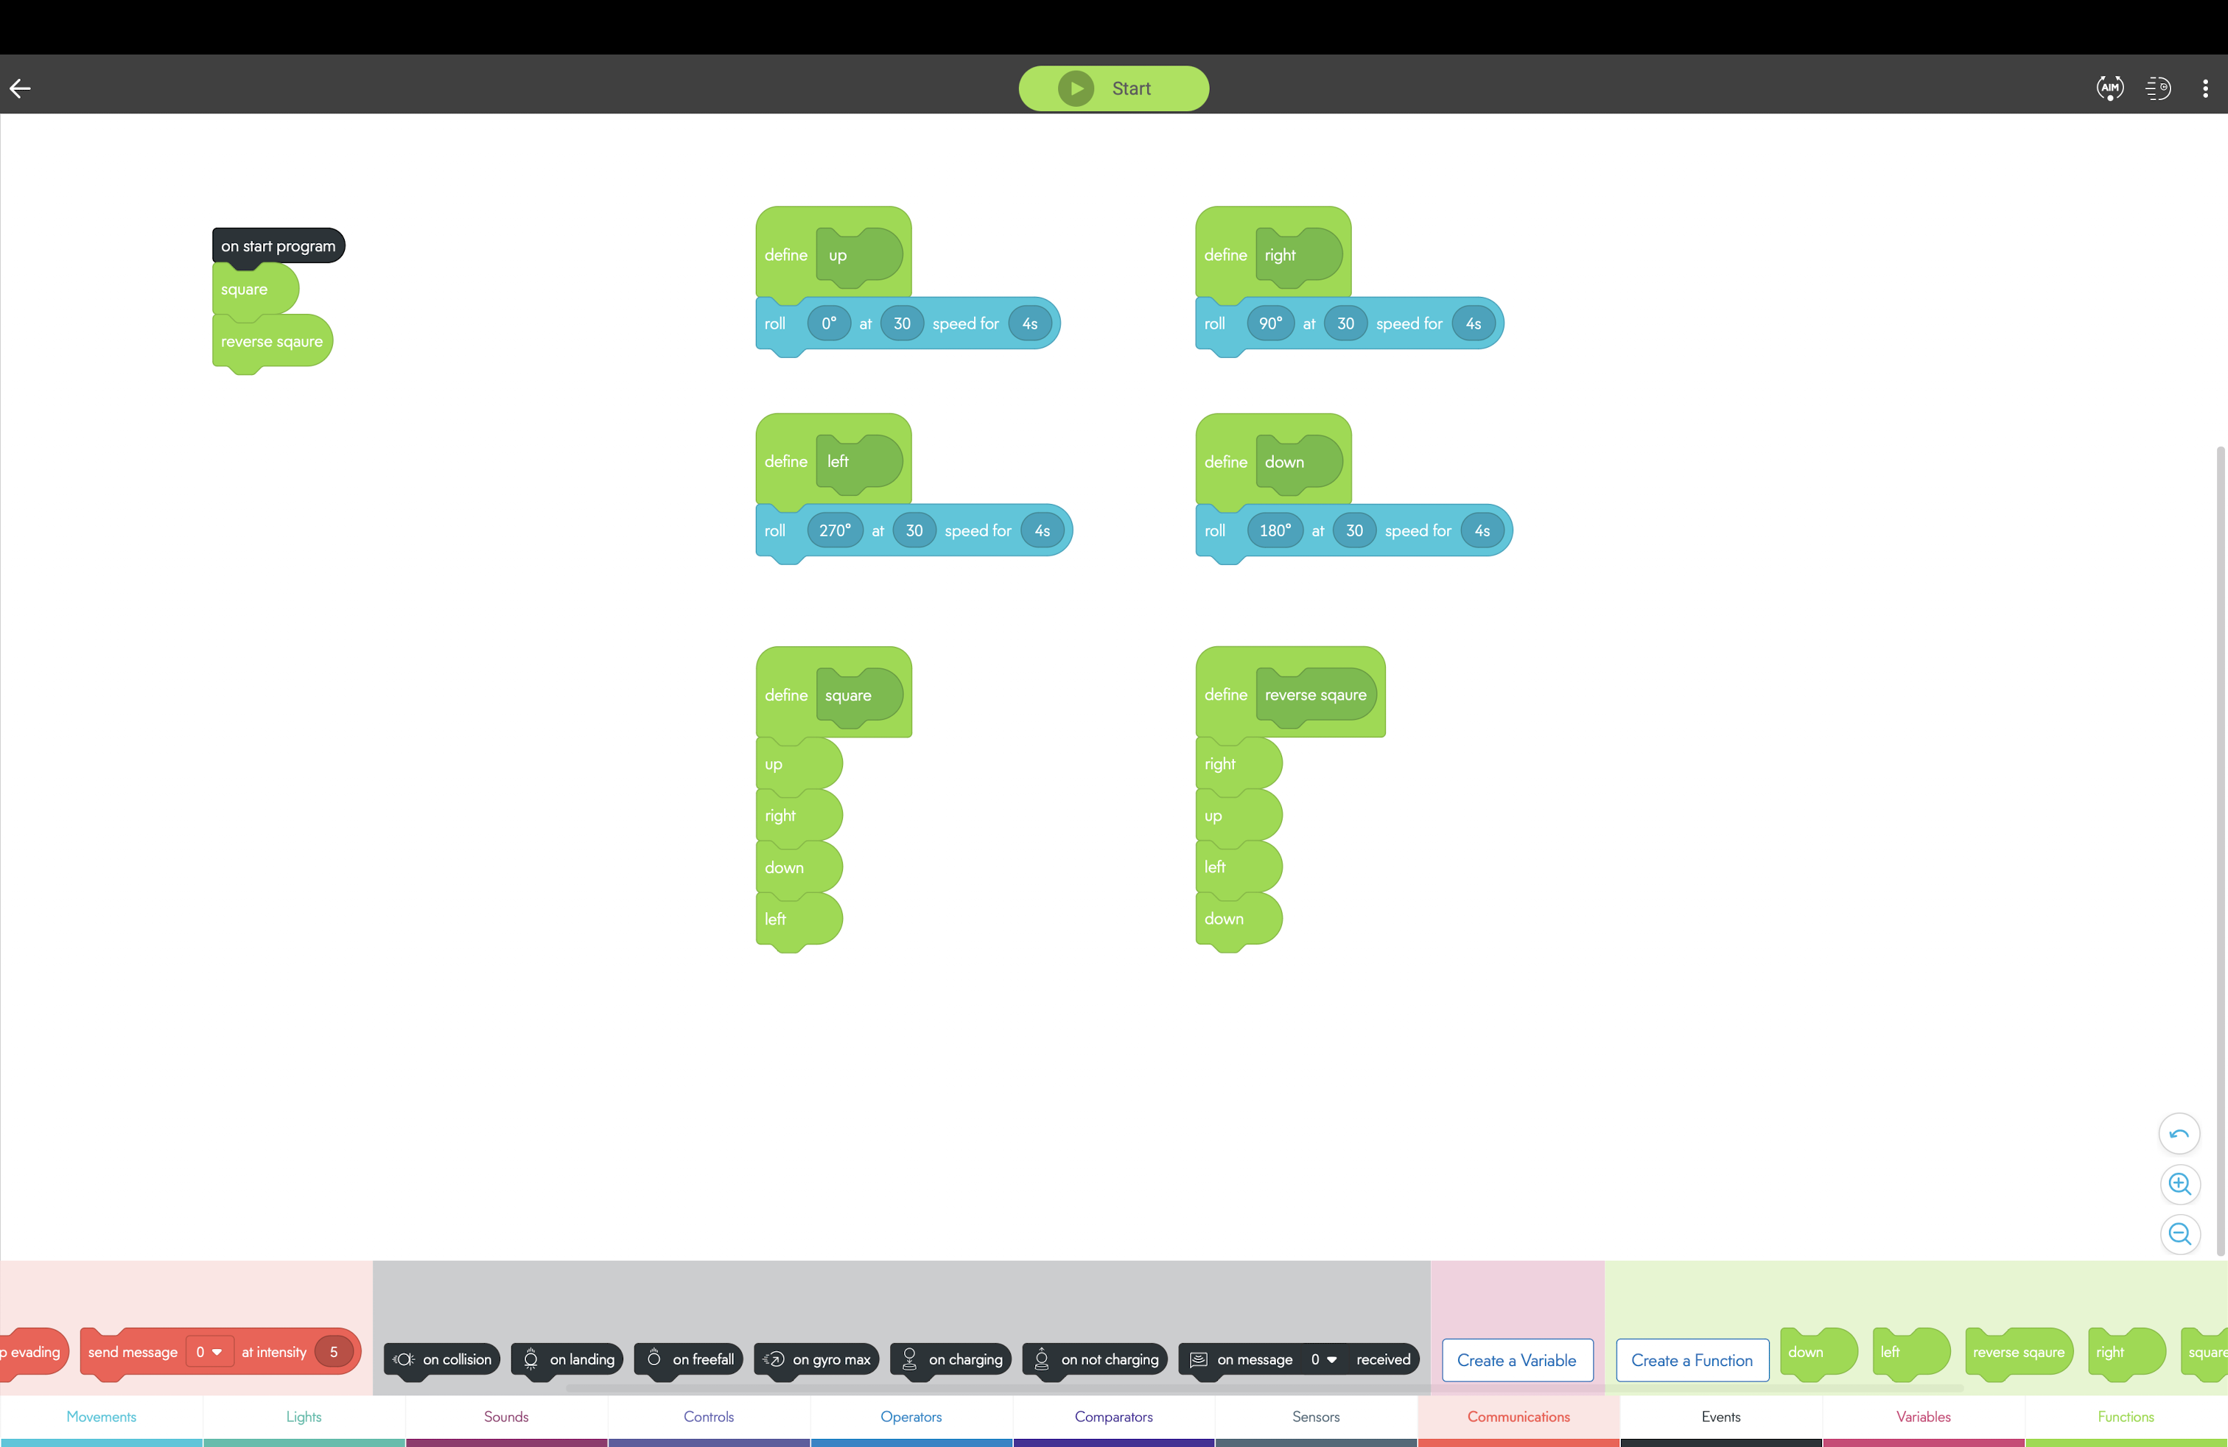
Now let's run your code!

Slide 22
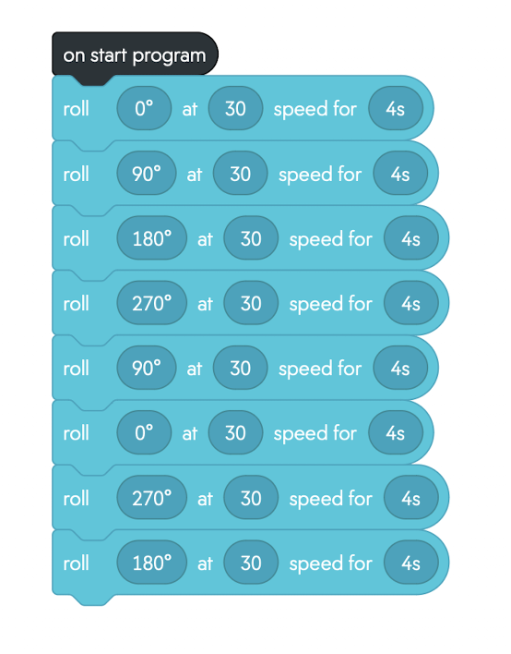
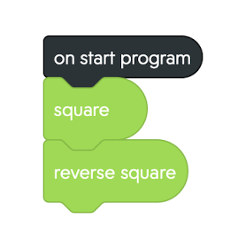
Program with functions
Same program without functions
*Note that the program with functions is more efficient and easier to read

Slide 23
Want to Learn More?
ITEC-2120 (non-ITEC majors)
ITEC-2140 (ITEC majors)
Introduction to Programming
Variables, arrays, conditional expressions, control structures, and functions
Programming Fundamentals
Focuses on object-oriented programming concepts.
Builds a strong foundation for advanced programming courses and IT careers.

Slide 24
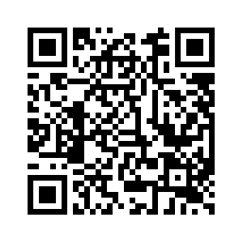
Please take the post-survey

Slide 25
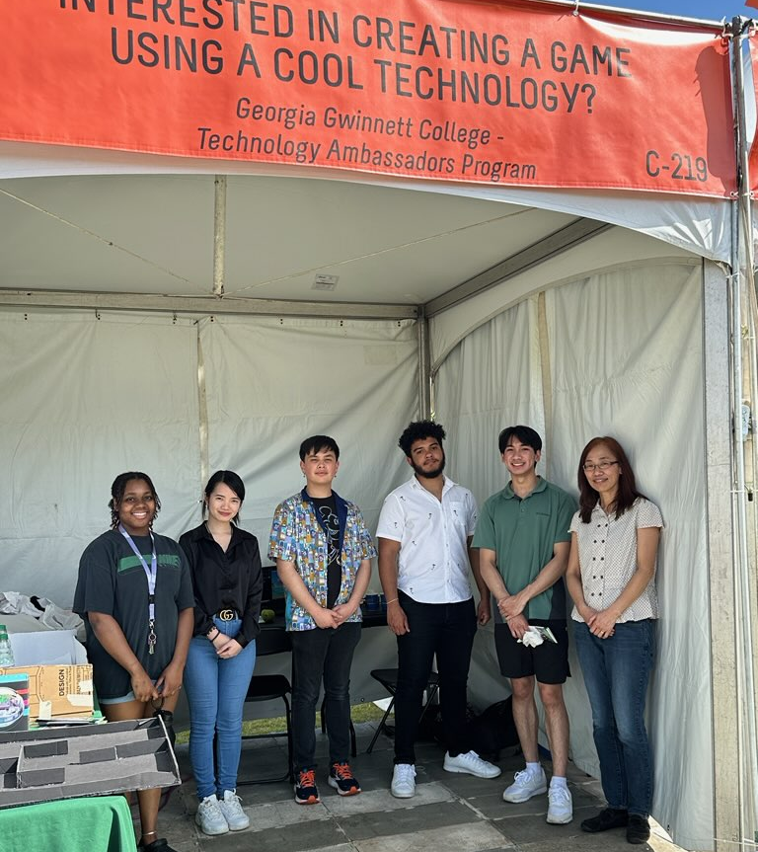
We hope you've found this presentation helpful, and we encourage you to continue exploring the possibilities of Sphero and other robotics platforms. Thank you for joining us today!

